Slide 1
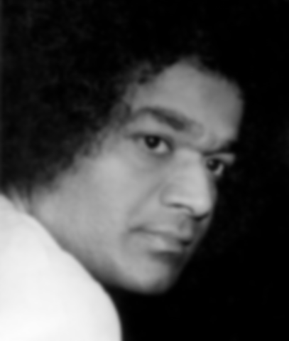
Leading a Spiritual Life
Self Confidence

Slide 2

It’s a supplemental doc (!)
Please read the newsletter before conducting the study circle with this document.

Slide 3
Purpose of Study Circle
Understand what Self Confidence means
Appreciate the importance of developing Self Confidence
Differentiate between ego consciousness and confidence arising from the Divinity within
Learn to build Self-Confidence and practically apply the techniques in day to day living

Slide 4

Opening meditation
3 Oms, sitting in a circle. The facilitator leads the below:
Close your eyes. Visualize Swami sitting in the middle of the circle. Now visualize a connection between your heart and Swami’s heart in whatever form that comes naturally to you. It could be in the form of a golden thread, or a beam of light, etc.
Ask Swami to send His unconditional love through that connection to you.
Feel the strong powerful energy enter your heart from Him.
Now visualize the same connection between Swami and everyone present in the room. Visualize everyone connected to Swami like spokes of a wheel connected to the center.
Thank Swami for His love and guidance.

Slide 5

Understanding the Topic: What is Self Confidence?
Have the moderator go around and ask everyone to complete the following sentence: “Self Confidence is _____”.
The moderator may choose to write the answers on a poster or a sheet of paper so others can see.

Slide 6
Understanding the Topic: What is Self Confidence?
What are some terms or values that are related to self confidence? (ex: self-esteem, faith, love)
How does a person with self-confidence look, think, speak and act? You may also list people from history who exhibited Self Confidence.

Slide 7
Activity 1: Role-Play
The purpose of this exercise is to think about the role-models in your life and how would they handle a certain situation from your life
Start by choosing your role-model. Think of any person alive or dead, real or fictional, whose attitude and Self-Confidence you admire. Why did you choose him/her?
Remember a situation or a problem from your own life where you feel/felt fearful and aren’t/weren’t fully confident. Re-enact that same situation as if you were the role-model you chose.
How would Swami handle the same situation?
Consider how this person would move, act, think, speak, and feel under a certain situation. If you can remember, give a specific example from his/her life.
What was different in the way you handle(d) the situation and the way your role-model handled the same situation?
Source: http://www.livestrong.com

Slide 8

Digging Deeper…importance of Self Confidence
Why should you develop Self confidence?
What benefits do you derive from developing Self Confidence?
What does Swami mean when He says that Self Confidence is the foundation to achieve Self Realization?

Slide 9
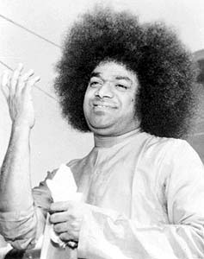
Difference between the ego, and God
When do you feel most confident in yourself or your ability to accomplish a goal?
When do you feel the need to rely more on God within?
Should there ultimately be a balance between both (confidence in individual self and confidence in God)? Why or why not?

Slide 10

Building Self Confidence
What are some ways to build Self Confidence?
How do affirmations benefit and help you in building Self Confidence? An example of an affirmation is ‘I am God’ and is used to remind oneself of a personal statement or saying.
List some positive affirmations for building Self Confidence.

Slide 11
Activity 1: determine if the character is acting from Swami’s definition of self-confidence.
Scenario # 1
Roger is playing in a tennis tournament and he wishes to play his best and win the grand prize. He is confident in his abilities that he has the skillset to beat anyone in the field as long as he is focused. He eventually accomplishes his goal and wins the tournament because of his confidence.

Slide 12
Activity 1: determine if the character is acting from Swami’s definition of self-confidence.
Scenario # 2
Every year on January 11th, Prashanthi Nilayam plays host to the renowned Sports Day. In the past, students have jumped through rings of fire, performed stunts on motorcycles, and conducted several other dare-devil tasks. Tremendous amounts of work and practice go into perfecting these events because the students want to please Swami. Knowing very well that the sporting activities are challenging, the Students perform them in front of huge crowds exuding extreme confidence.

Slide 13
Activity 1: determine if the character is acting from Swami’s definition of self-confidence.
Scenario # 3
An extremely brilliant surgeon is getting ready to perform a complicated surgery the following day. The risks involved are severe, but the surgery is absolutely necessary to help the patient survive. The surgeon reviews the patient file before and fully details the necessary procedure to conduct a successful surgery. On the day of the surgery, he asks the assistance of his team to help him complete it and thanks them for their contributions. After the surgery, the patient’s family thanks the surgeon, which he accepts with humility.

Slide 14
Activity 2: Self-Confidence Worksheet
Note: This activity can be done individually or in a group
Part 1:
Think of a situation in which you experienced confidence, or followed Swami’s guidance/your conscience. Answer the following questions:
  Describe the situation.
  What were you saying / thinking to yourself about that situation?
  How did you feel physically/mentally? What sensations did you have in your body, if any?
  What did you do as a result of this situation?
Source: http://www.self-esteem-experts.com

Slide 15
Activity 2: Self-Confidence Worksheet
Part 2: Think of a situation in which you were anxious or showed lack of confidence. How would you change that if you could? Answer the same questions as in Part 1.

Slide 16
Activity 2: Self-Confidence Worksheet
Part 3: Consider the situation you described in Part 2. Using the information you learned about your self from Part 1, ask yourself the following questions:
  What positive statement can I say to myself to be reminded of Swami within?
  What could I do that will help me feel/react differently?
  What can I do differently next time I’m in that situation?

Slide 17
Swami’s quote describing some qualities of a person lacking self-confidence:
"For, loss of confidence in the Atma or Self involves loss of faith in God Himself. That Omnipresence, that Inner Motivator of all, who is the warp and woof of our body and mind, our emotions and intellect - strengthening faith in Him is the only means of realising the highest goal of man. This is the lesson that Bharathiya spiritual history longs to teach. Children of Bharath! Teach your children this life-preserving, glorious and heart-expanding Truth from the early days of life." (Sathya Sai Baba: Vidia Vahini. Religion is Experience, p. 28).”

Slide 18
Challenging Real Life scenarios:
1) Describe some situations or circumstances when practicing Self-
Confidence becomes challenging.
2) Take a couple of minutes to think about the following scenarios (in the next 3 slides) and then discuss them among the group. For each scenario:
Discuss how you would react to the situation keeping in mind Swami’s definition of Self-Confidence, i.e. confidence in the ‘aatma’.

Slide 19
Challenging Real Life scenarios:
Scenario # 1
You are a hard working student , parent, or professional. After many years of sincere effort and dedication, you present your results on an important project that you have been passionate about and working very hard on. The committee member takes one look at it and feels it has to completely re-tailored. In other words, years of hard work needs to be re-written or reworked on.

Slide 20
Challenging Real Life scenarios:
Scenario # 2
You just landed your first job in your dream company. After a while, due to the economy, you get laid off with no possibility of coming back to the company for at least a few years as they are downsizing all positions that meet your skills and training.

Slide 21
Challenging Real Life scenarios:
Scenario # 3
You are a new parent. After the bundle of joy stepped into your life, you no longer have time for your career or academic pursuits. You are just ripe in your career for a promotion. But you know that taking up the promotion means taking away time from your child.

Slide 22
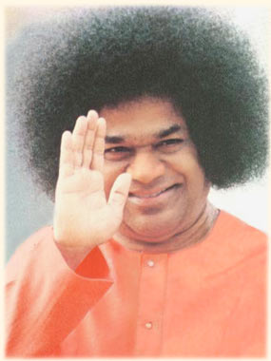
Finish with Om, 3 Shantis.

Slide 23
Independent Study: Prema Vahini
Refer to Newsletter Document: Read Chapters 1-7, answer the multiple choice questions, and perform the activity in the newsletter document
The answers to the multiple choice questions are as follows:
1. A
2. D
3. A
4. A
5. C
6. B
7. B
8. D
9. D
10. A

